Slide 1
我们7：05开始

Slide 2
CS1010 Placement Test AY2025-26 (7 July 2025) Liu Yuqi E-mail: e1513087@u.nus.edu The first draft of the solutions for AY2025-26 was provided by Liu Yuqi.
CS1010 Advanced Placement Credit
Examination Preparation for
S&T2025 Scholars (Set 12)

Slide 3
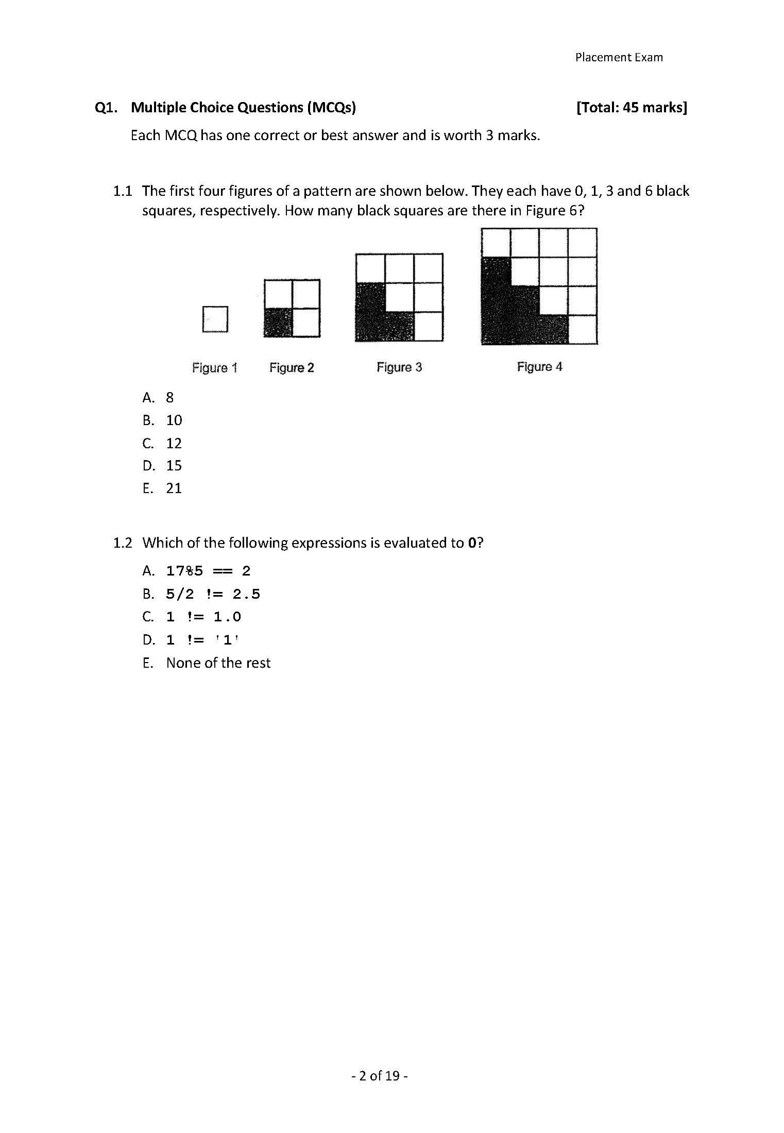
D
Answer:

Slide 4


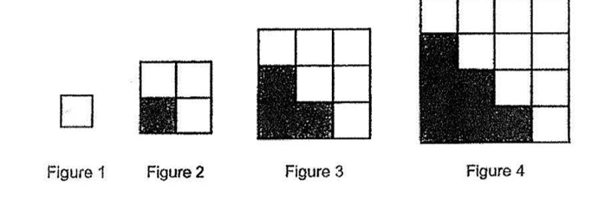
Figure 5
Figure 6
+1
+2
+3
+4
+5
6
10
15

Slide 5
C
Answer:

Slide 6




“evaluated to 0” ➔ the expression is false
5 * 3 + 2 = 17 ➔ true
Both 5 and 2 are integers ➔ 5 / 2 = 2 ➔ true
1 is an int
1.0 is a double
Before comparison, C will convert both operands to the same type.
➔ the integer 1 is promoted to double, becoming 1.0.
➔ the comparison between 1.0 & 1.0
They are exactly equal in value and type at this stage.
➔ false
1: integer
‘1’: character
Different types of variables. ➔ true

Slide 7
什么时候转换，什么时候不转换？
✅ 会触发 int → float/double 隐式转换的 6 种场景
1. 算术运算 Arithmetic + - * /
一边 int，一边 float/double → int 上浮为浮点
例：5 + 2.0、10 / 3.0
2. 比较运算 Comparison > < == !=
两边类型不同，int 转为浮点再对比
例：1 == 1.0、5 != 2.5
3. 赋值运算 Assignment =
左边变量是 float/double，右边是 int → int 转浮点（“小转大”）
例：float f = 8;
4. 函数传参 Function argument
形参 float/double，实参传入整数 int
例：void show(float x); show(6);
5. 函数返回值 Return value
函数返回类型 float/double，return 写整数
例：double func(){ return 3; }
❌ 不会触发 int 转浮点（无隐式转换）
1. 两边全是整数 int /int或float
全部操作数都是整型，只做整数除法，不转浮点
例：5 / 2 → 结果 2，不是 2.5
2. 赋值：左 int，右 float/double
浮点转 int（截断小数，向下转换，不属于 int 上浮）（“大转小”）
例：int a = 2.9; → a=2
3. 模运算 Modulo %
% 只能用于两个整数，不能出现 float/double，编译报错
例：5 % 2 合法；5 % 2.0 报错，不存在转换

Slide 8
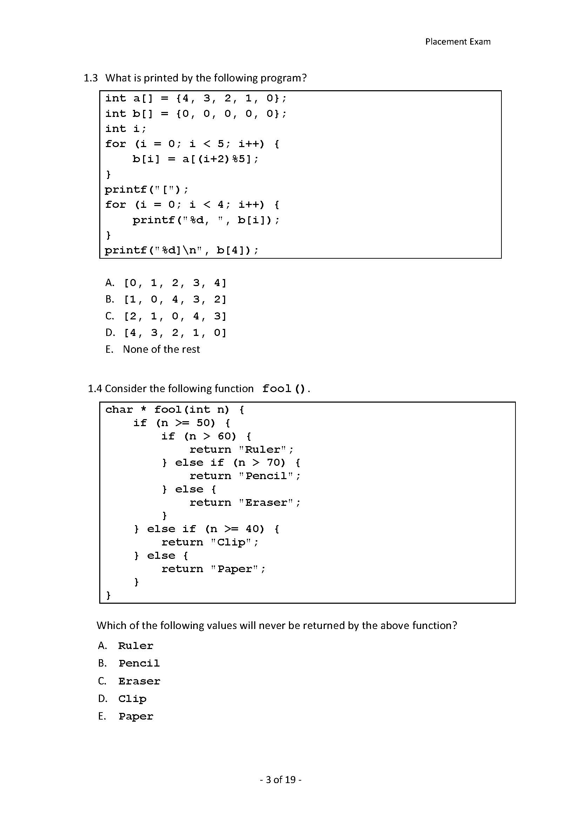
C
Answer:

Slide 9
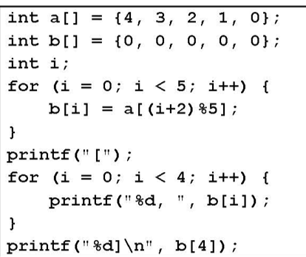
a | a[0] | a[1] | a[2] | a[3] | a[4]
- | 4 | 3 | 2 | 1 | 0
b | b[0] | b[1] | b[2] | b[3] | b[4]
- | 0 | 0 | 0 | 0 | 0
2
1
0
4
3
i = 0: b[0] = a[ (0 + 2) % 5] = a[2] = 2
Output:
i = 1: b[1] = a[ (1 + 2) % 5] = a[3] = 1
[2, 1, 0, 4, 3]
i = 2: b[2] = a[ (2 + 2) % 5] = a[4] = 0
i = 3: b[3] = a[ (3 + 2) % 5] = a[0] = 4
i = 4: b[4] = a[ (4 + 2) % 5] = a[1] = 3

Slide 10
Pencil
Answer:

Slide 11
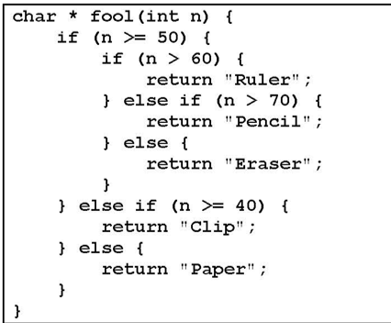
Paper
Clip
Eraser
Ruler
Pencil
40
50
60
70
The range from 60 to infinity has included the new range from 70 to infinity. So “Pencil” will not be printed on the screen.

Slide 12
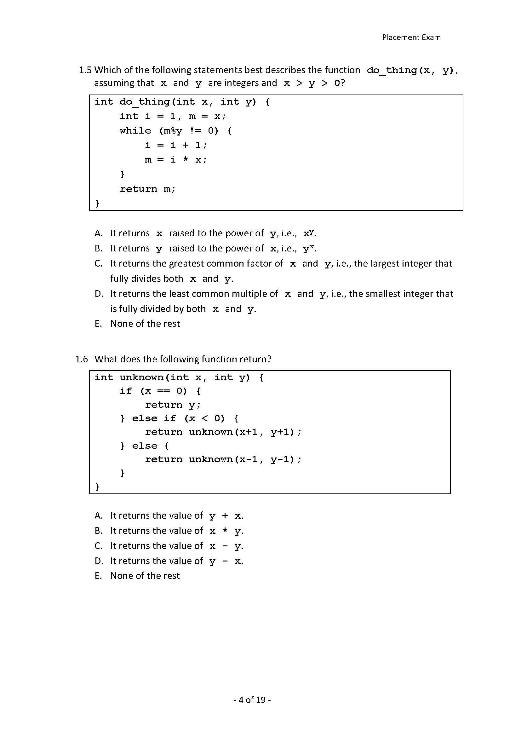
D
Answer:

Slide 13
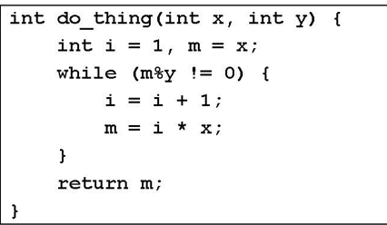
Make an example:
do_thing (int x = 2, int y = 3)
m = 2; i = 1;
2 % 3 != 0
i = 2;
m = 4;
4 % 3 != 0
i = 3;
m = 6;
6 % 3 == 0
➔ return 6;
➔ Cannot select A, B, nor C
This algorithm keeps m a multiple of x, and try to find an m that is also a multiple of y, and then return that m.
Find the least common multiple of x and y.

Slide 14
D
Answer:

Slide 15
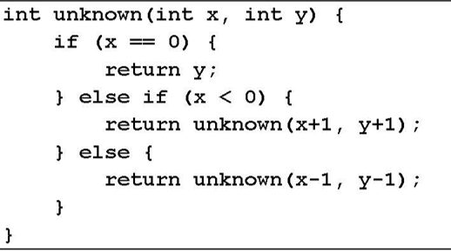
Make an example:
Unknown (int x = 2, int y = 3)
2 > 0
unknown (1, 2);
1 > 0
unknown (0, 1);
0==0
➔ return 1;
Try to plus 1 or minus 1 on x and y at the same time to turn x to 0. ➔return the new y, which is original y minus original x

Slide 16
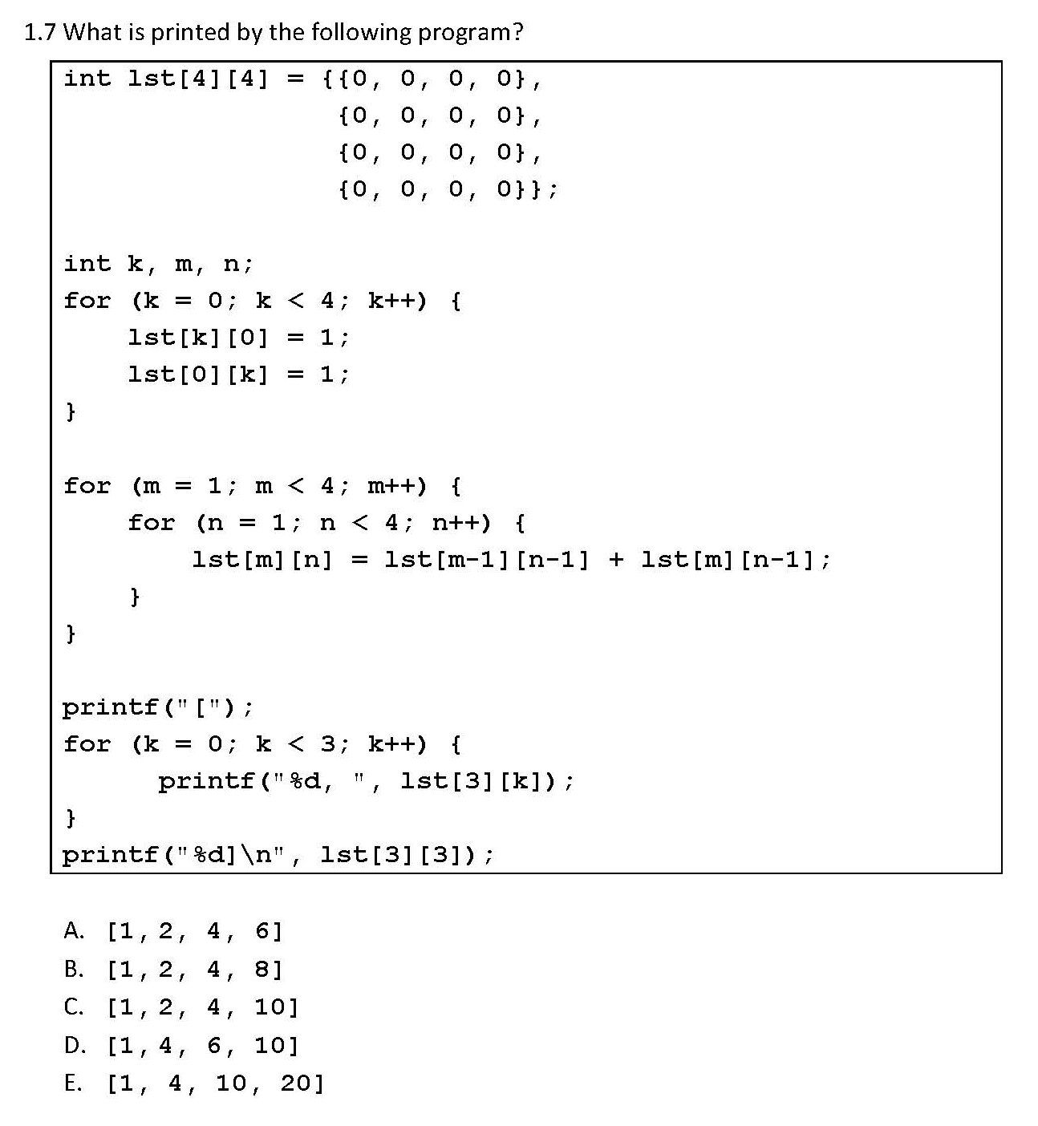
B
Answer:

Slide 17
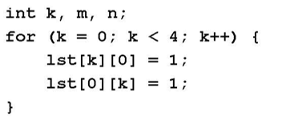
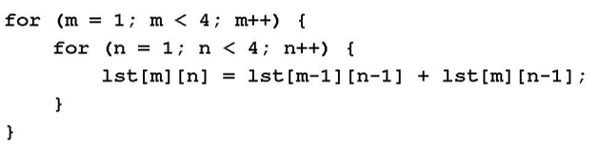
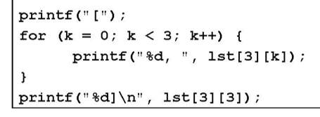
lst | [0] | [1] | [2] | [3]
[0] | 0 | 0 | 0 | 0
[1] | 0 | 0 | 0 | 0
[2] | 0 | 0 | 0 | 0
[3] | 0 | 0 | 0 | 0
1
1
1
1
1
2
3
4
k = 0, 1, 2, 3
1
2
4
7
1
2
4
8
m -1, n - 1
m, n - 1
m, n
The output:
[1 2 4 8]

Slide 18
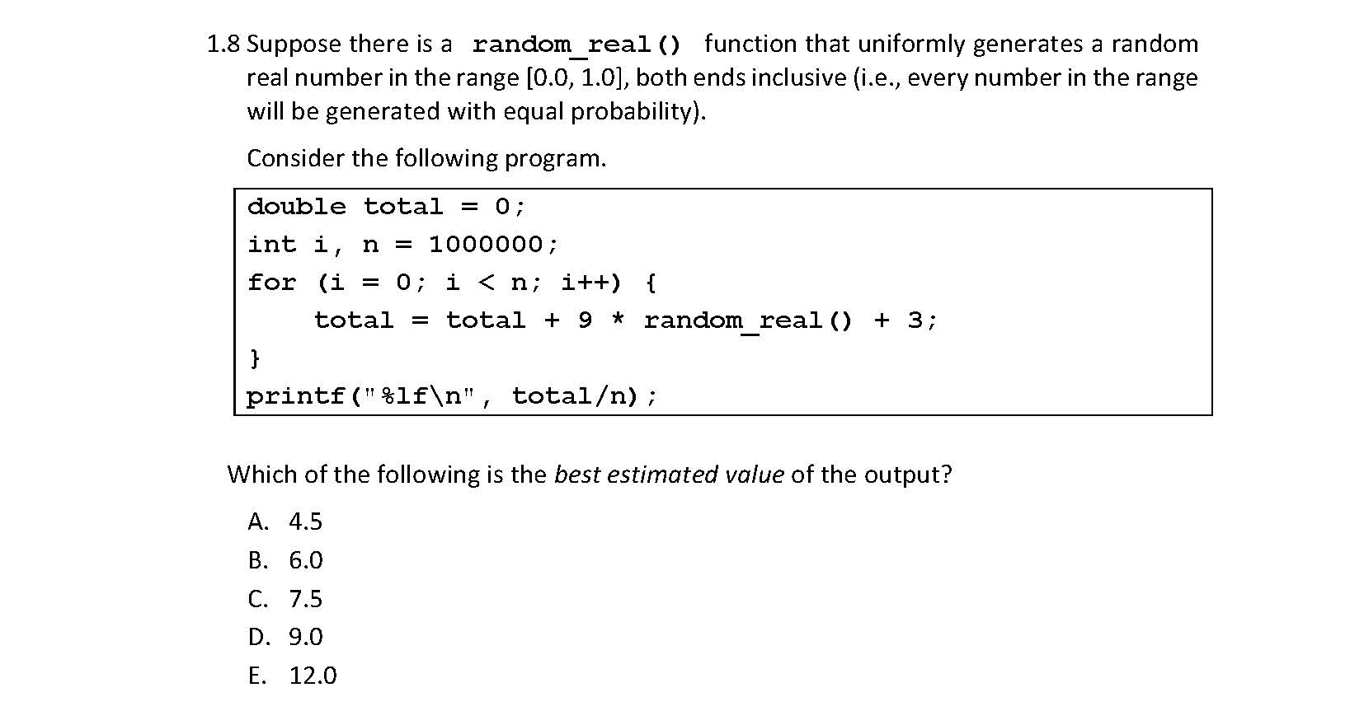
C
Answer:

Slide 19
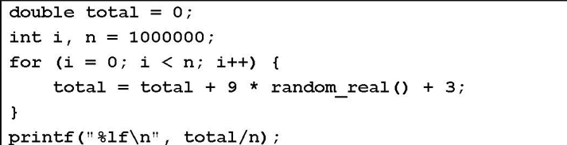
[ 3.0, 12.0 ]
[ 0.0, 1.0 ]
Mean:
7.5

Slide 20
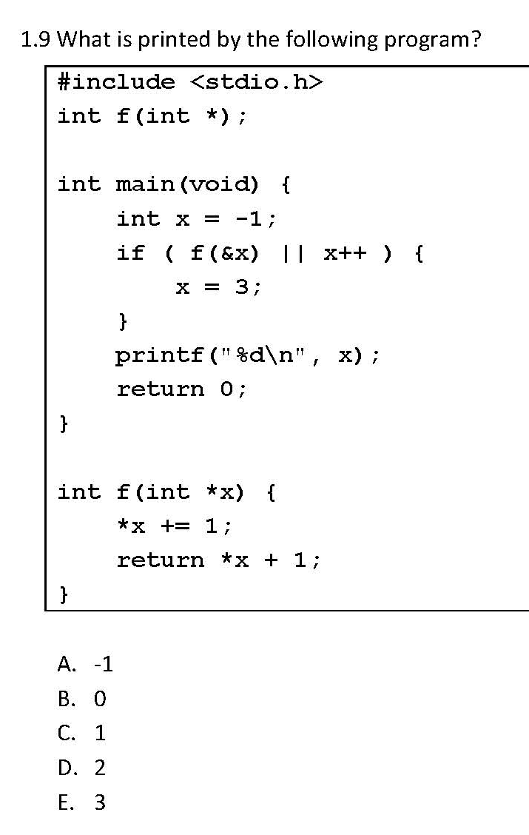
1
0
3
1
E
Answer:
The output: 3

Slide 21
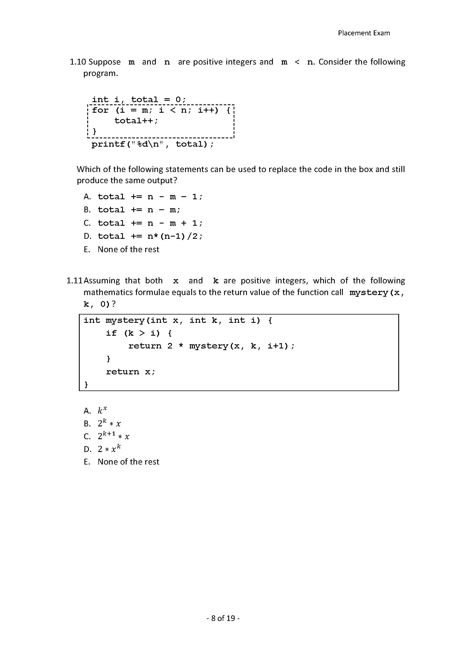
B
Answer:

Slide 22
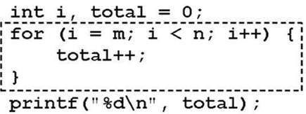
Make an example:
m = 3, n = 5;
i = 3;
total = 1;
i++;
i = 4;
total = 2;
i++;
i = 5 ➔leave the loop
total = 2
Plus 1 on total when m > n
➔ To calculate n-m
So the code in the box can be replaced by total += n – m;

Slide 23
mystery(x, k, 0)
= 2 * mystery(x, k, 1)
= 2 * 2 * mystery(x, k, 2)
……
= 2 * 2 … * 2 * mystery(x, k, n)
B
K == n
➔ Return x
Answer:
n个2
➔ Final output: 2^k * x

Slide 24
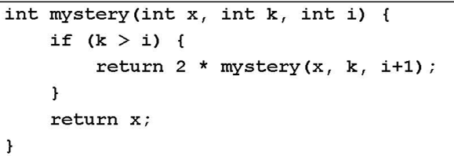

Make an example:
mystery (x = 5, k = 3, i = 0);
1) 3 > 0;
2 * mystery (5, 3, 1);
2) 3 > 1;
2 * 2 * mystery (5, 3, 2);
3) 3 > 2
2 * 2 * 2 * mystery (5, 3, 3);
4) 3 == 3
➔ return 2 * 2 * 2 * 5
Find the result of k-i
2 in power of (k – i) times x
mystery (x, y, 0) = 2 in power of k times x

Slide 25
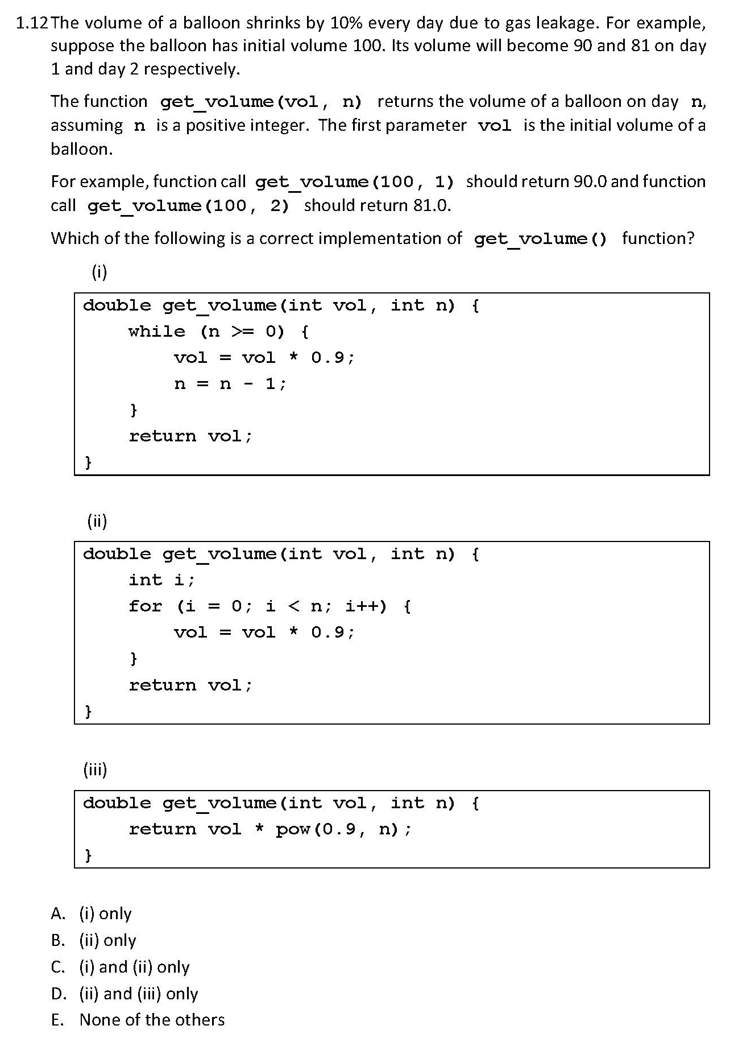
D
Answer:
Initial volume * 0.9^n

Slide 26
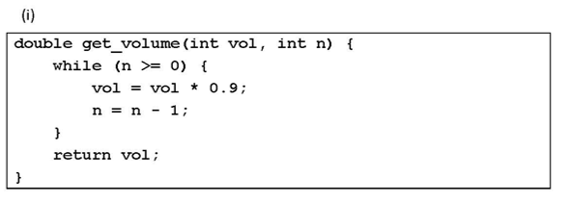
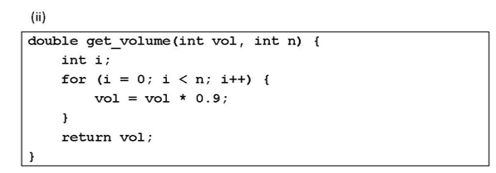
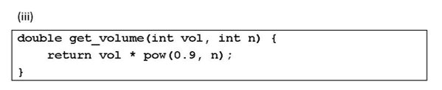
For example:
get_volume (100, 1)
➔
vol = 90;
n = 0;
vol = 81;
n = -1;
➔ return 81;
Wrong!
While loop repeats (n+1) times
Should be
while (n > 0)
Correct.
for loop repeats n times.
Correct.
for loop repeats n times ⬄ 100 times 0.9 in power of n

Slide 27
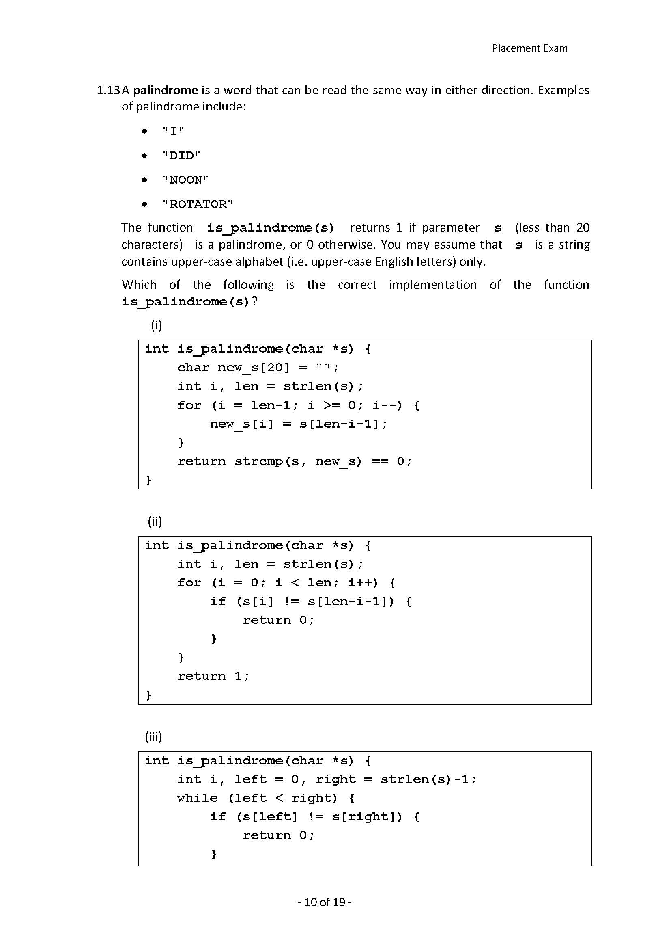
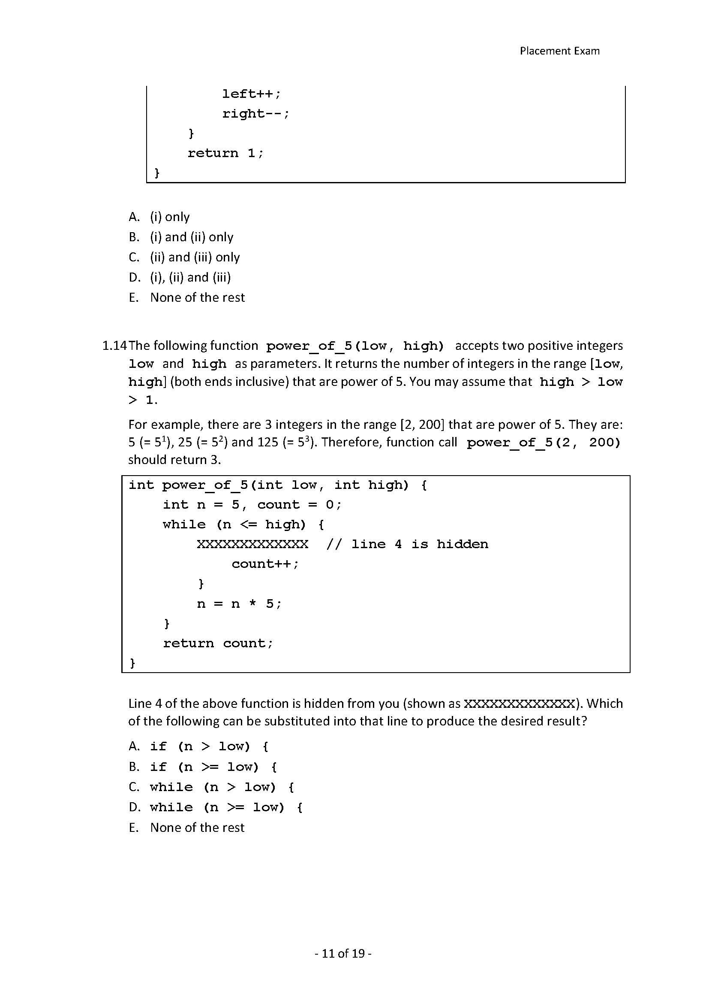
C
Answer:

Slide 28
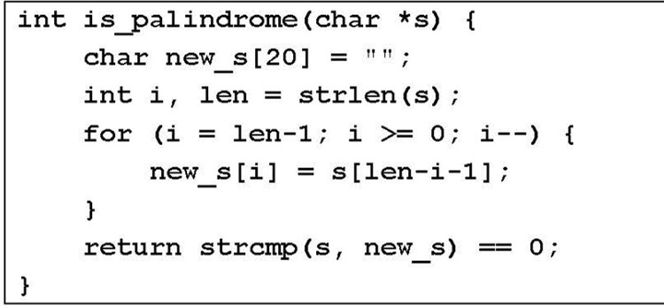
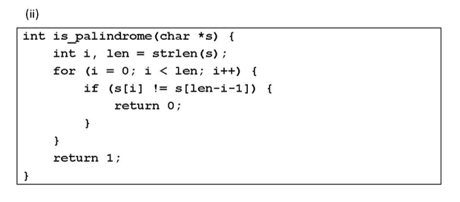
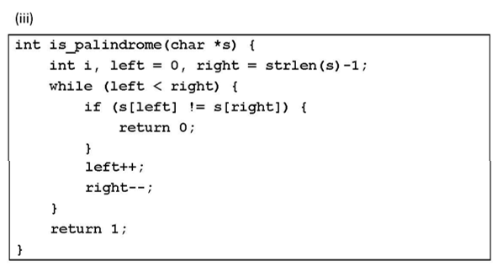
Create a new string new_s to store the reversed version of string s.
And then compare new_s and s
But there is no null terminator ‘\0’ in new_s
➔ wrong
Compare the kth character in the string with its (len – k – 1) th character.
➔ correct
The same as (ii).
Compare the kth character in the string with its (len – k – 1) th character.
➔ correct

Slide 29
B
Answer:

Slide 30
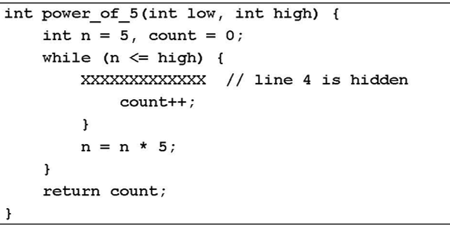
n is power of 5, and n should equal to or be greater than low and equal to or be smaller than high.
➔
Find all the suitable n and use count to count the number of n.
if( n >= low )
If it is a while loop
➔ n keeps the same value, but count keeps increasing. (infinite loop)

Slide 31
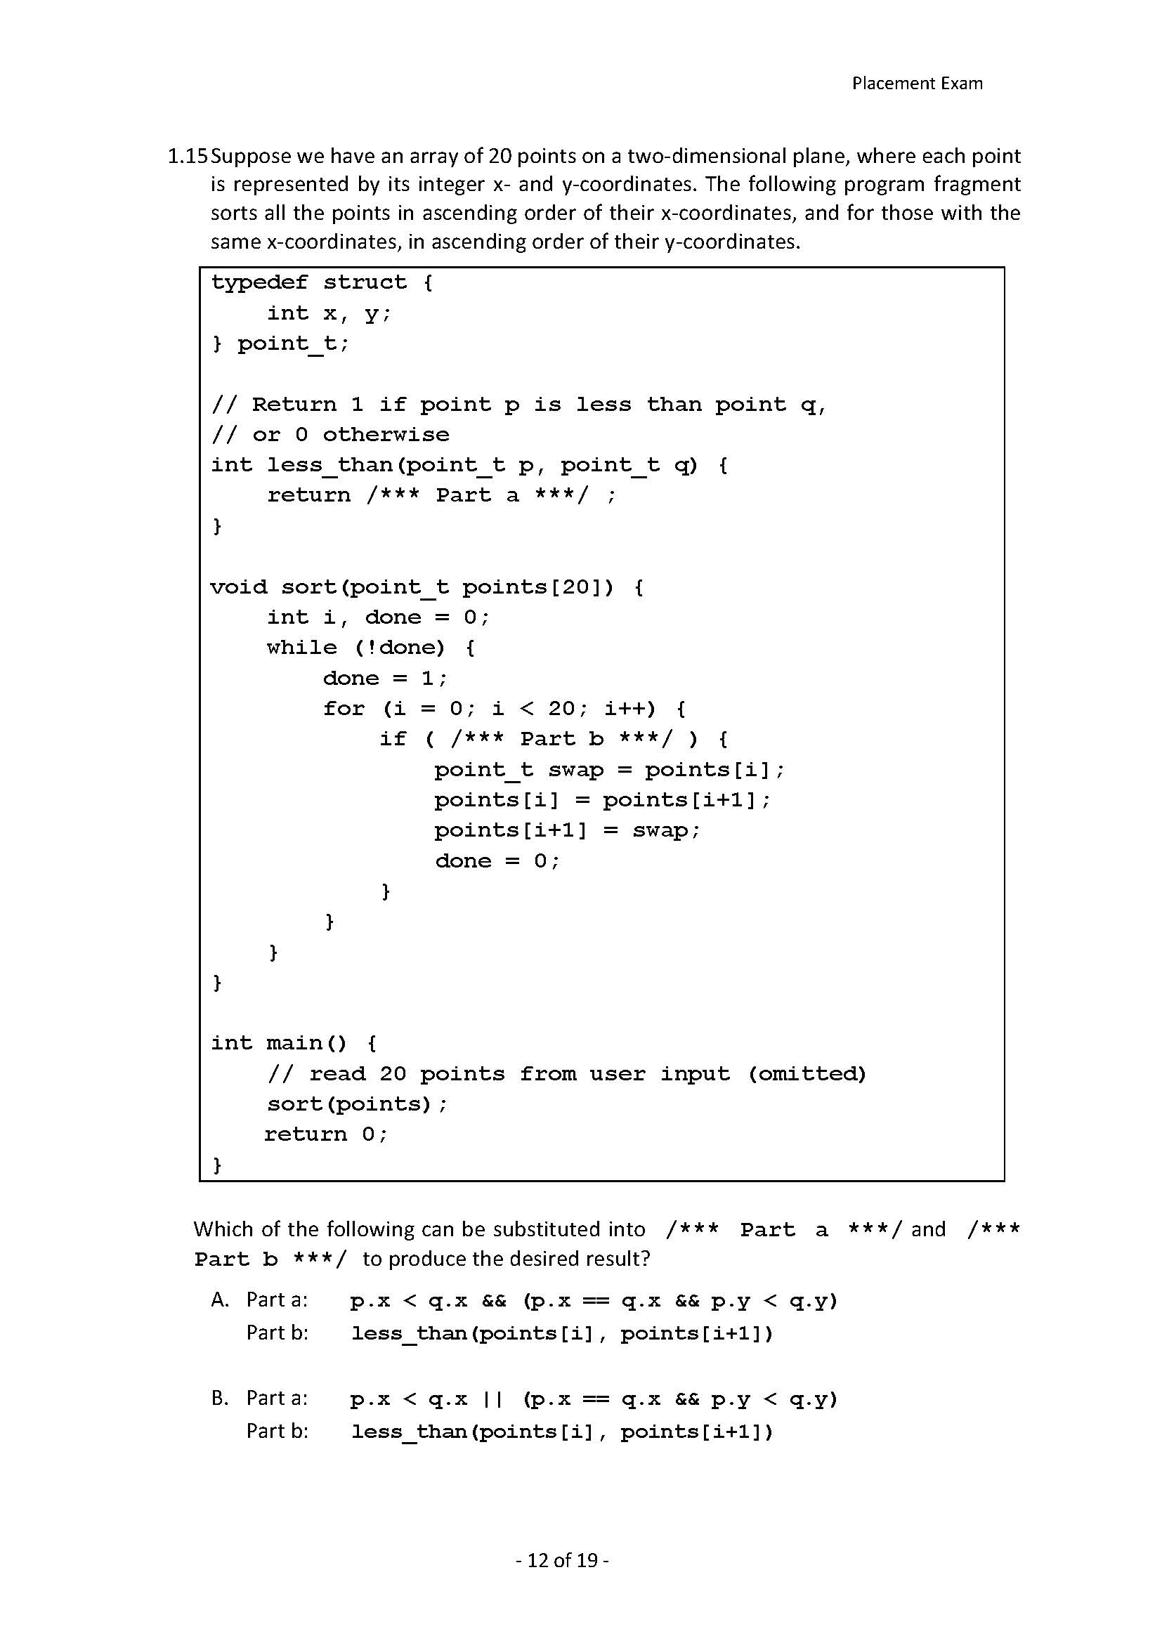
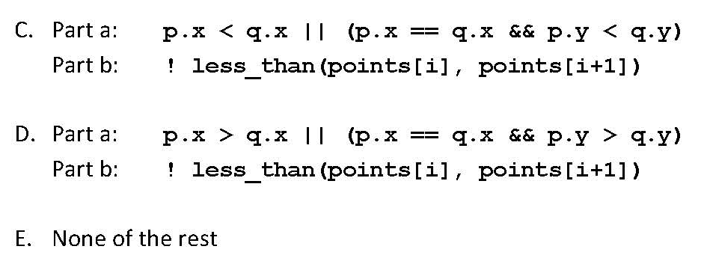
C
Answer:

Slide 32
Part a:
Compare the x-coordinates of p and q
If they are the same ➔ compare the y-coordinates of p and q
If not ➔ return
return 1 if p is smaller; 0 if q is smaller
if ( p.x < q.x || (p.x == q.x && p.y < q.y) ) return 1;
else return 0;
Part b:
To place all the points in ascending order
If point i is bigger than i+1
Swap
if ( less_than(points[i], points[i+1] == 0))

Slide 33
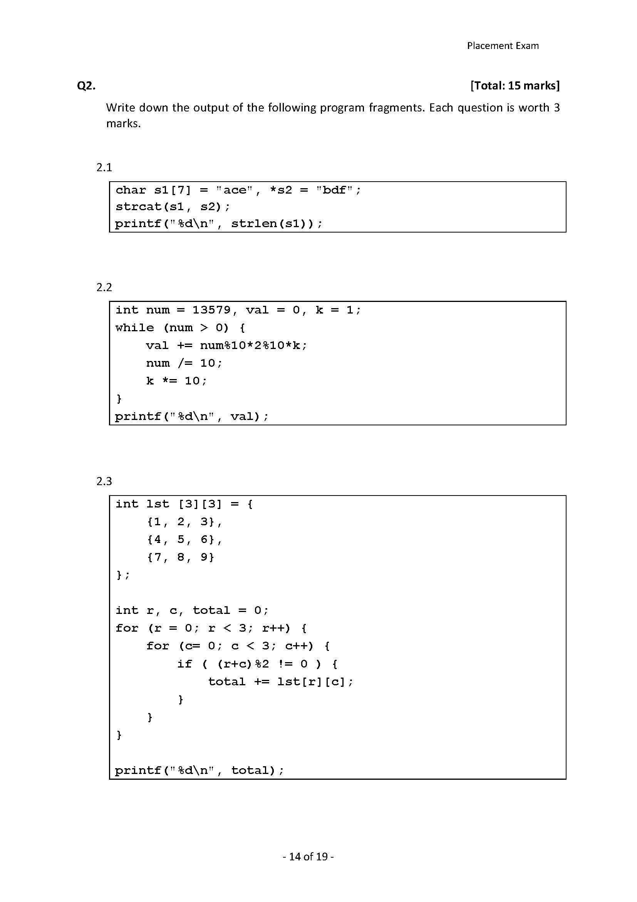
lst | [0] | [1] | [2]
[0] | 1 | 2 | 3
[1] | 4 | 5 | 6
[2] | 7 | 8 | 9
strcat ( char *s1, char *s2 ):
Find the end of s1
Copy the contents of s2 (including its terminating '\0') to the end of s1.
The function returns the new s1.
➔ output: acebdf
Answer:
6
Answer:
num = 13579; k = 1:
val = val + 9 * 2 % 10 * 1 = 8;
num = 1357; k = 10;
val = val + 7 * 2 % 10 * 10 = 48;
num = 135; k = 100;
val = val + 5 * 2 % 10 * 100 = 48;
num = 13; k = 1000;
val = val + 3 * 2 % 10 * 1000 = 6048;
num = 1; k = 10000;
val = val + 1 * 2 % 10 * 100 = 26048;
Output: 26048
26048
r = 0
1) c = 0 0 % 2 == 0
total = 0;
2) c =1 1 % 2 != 0
total = 2;
3) c =2 2 % 2 == 0
total = 2;
r = 1
1) c = 0 1 % 2 != 0
total = 6;
2) c =1 2 % 2 == 0
total = 6;
3) c =2 3% 2 != 0
total = 12;
3. r = 2
1) c = 0 2 % 2 == 0
total = 12;
2) c =1 3 % 2 != 0
total = 20;
3) c =2 4 % 2 == 0
total = 20;
Answer:
20

Slide 34
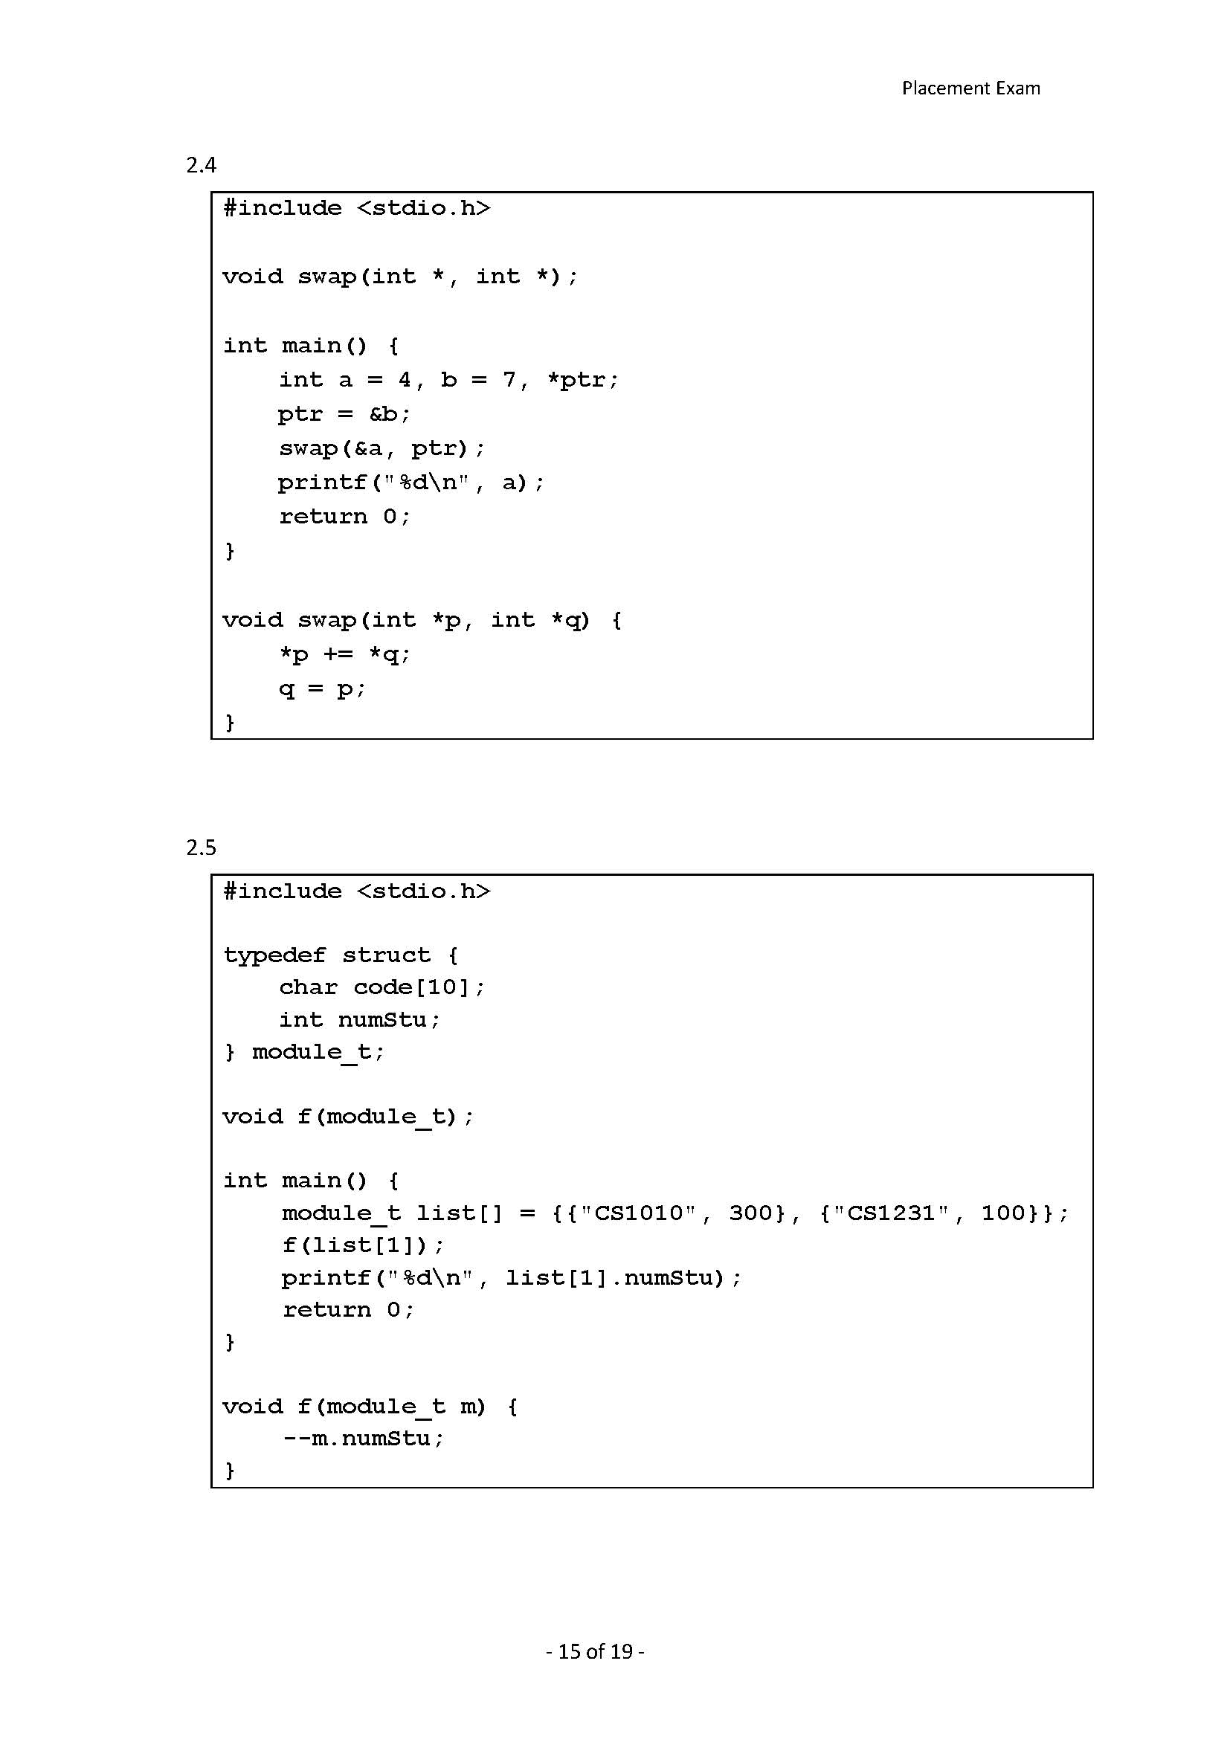
11
ptr
Answer:
It passes by value, not by address.
So this is the copy of module_t list, and will not make a difference on numStu.
list | [0] | [1]
code | CS1010 | 300
numStu | CS1231 | 100
11
Answer:
100

Slide 35
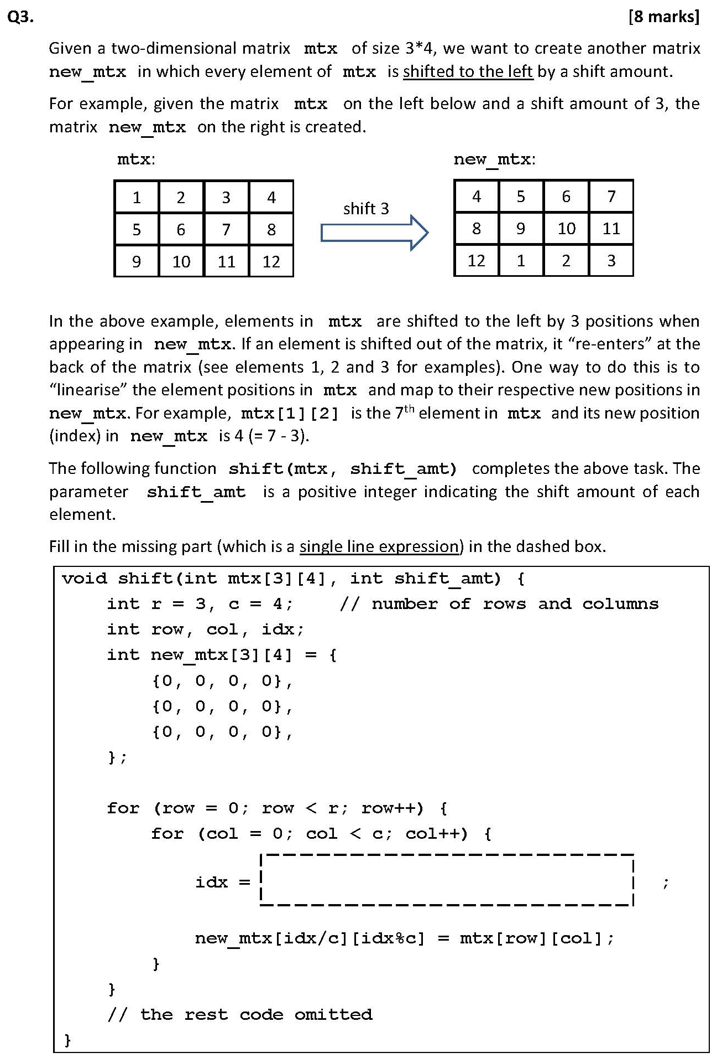
idx 本质：格子的编号
➔转换为row行col列
Answer:
移动前的idx是多少？
移动后的idx是多少？
mxt [1][2] ➔ 6th element (7)
➔
mxt [row][col] ➔ (row * 4 + col) th element
newID: 3
[3/4][3%4] ➔ [0][3]
Prevent it is negative
( (row * c + col) - shift_amt + r * c ) % (r * c);
Within 0 - r*c-1
Original idx

Slide 36
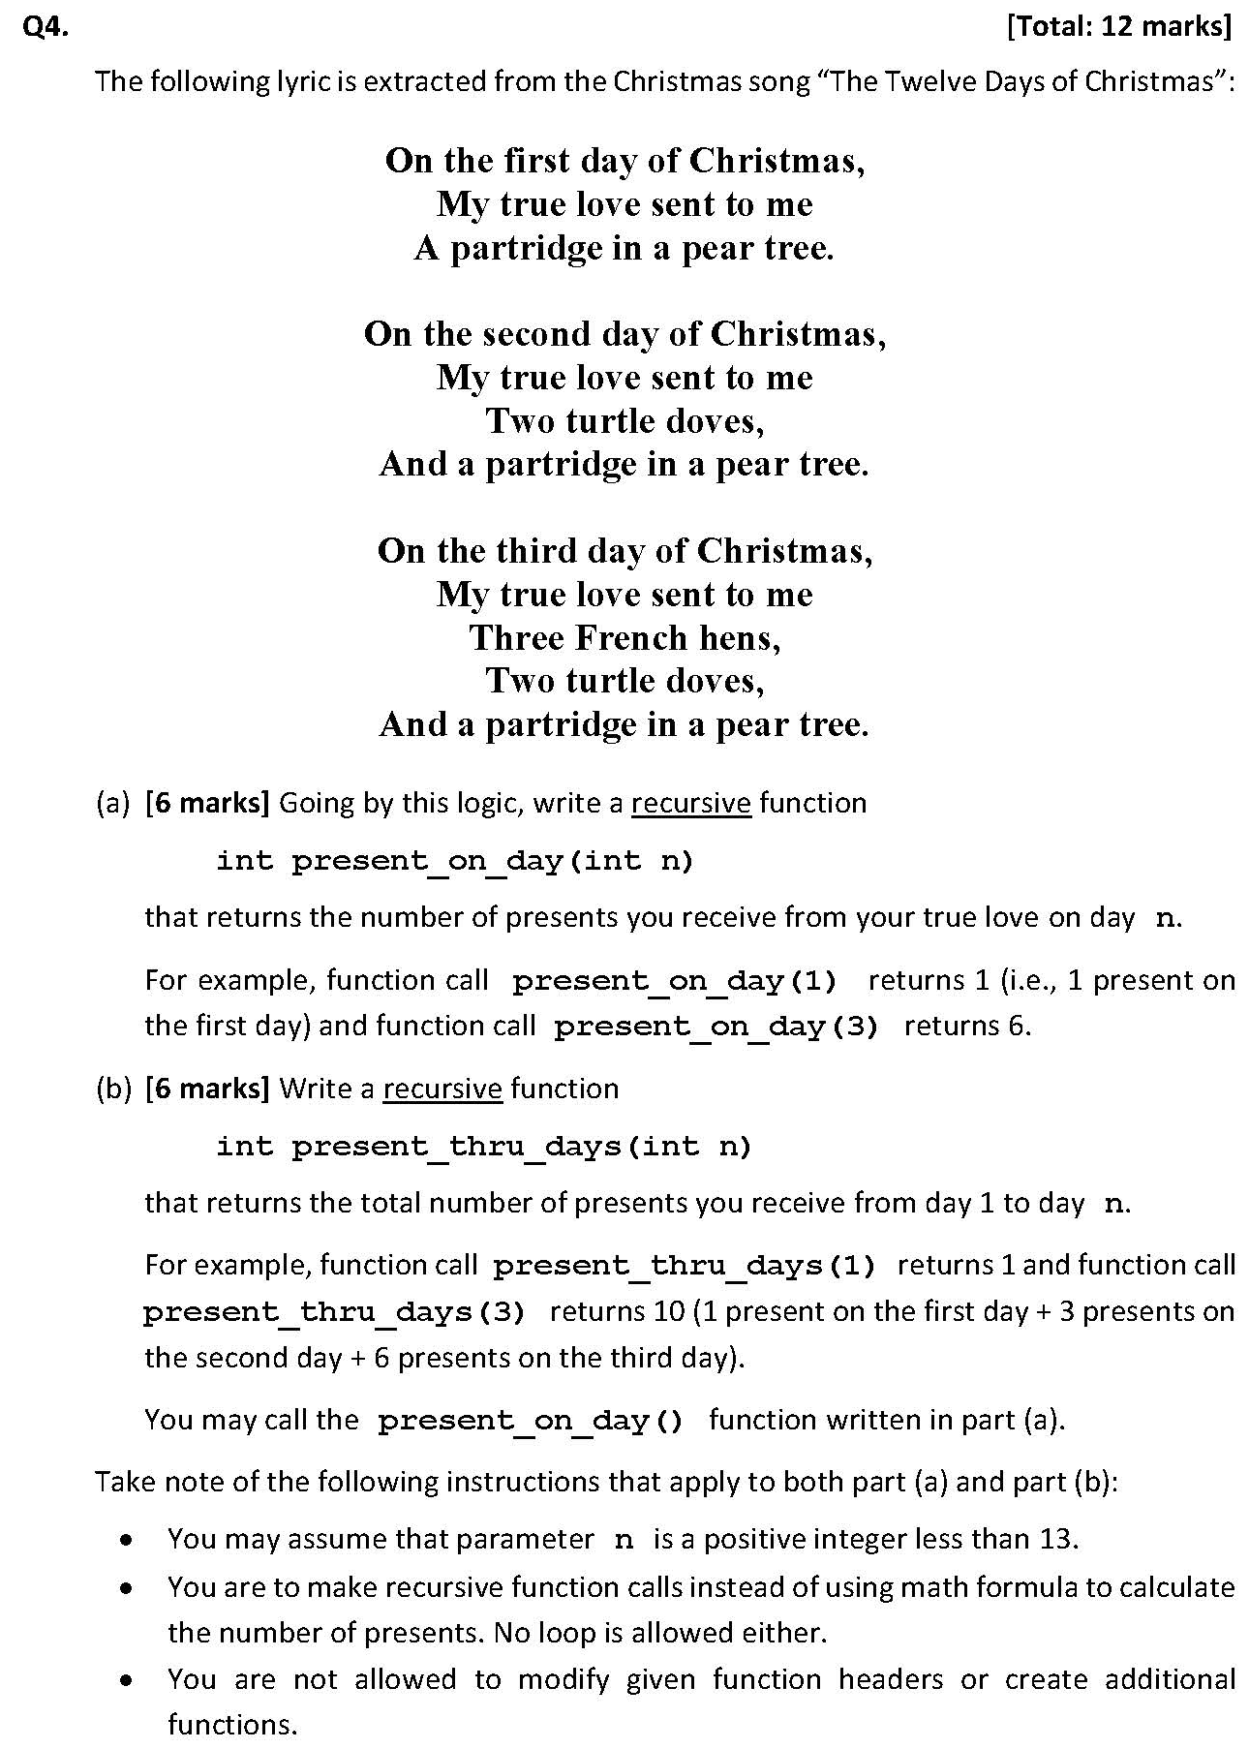
Base case
Answer:
(a)
present_on_day ( int n )
n = 1 ➔ 1
n = 2 ➔ 2 + 1 = 3
n = 3 ➔ 3 + 3 = 6
……
1
present_on_day ( 1 ) + 2
present_on_day ( 2 ) + 3
present_on_day(n-1) + n
present_on_day ( int n ) {
if ( n == 1 ) return 1;
return n + present_on_day ( n – 1 );
}

Slide 37
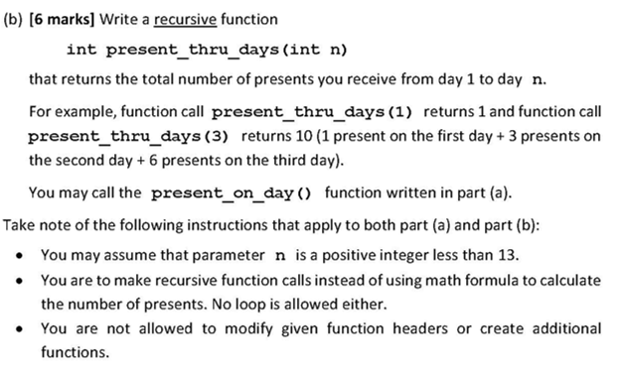
(b)
Base case
n = 1 ➔ 1
n = 2 ➔ 1 + 3 = 4
n = 3 ➔ 4 + 6 = 10
……
1
P_thru_days ( 1 ) + P_on_day ( 2 )
P_thru_days ( 1 )+P_on_day ( 3 )
p_thru_days(n-1) + p_on_day(n)
int present_thru_days ( int n ){
if ( n == 1) return 1;
return present_on_day ( n ) + present_thru_days ( n – 1 );
}

Slide 38
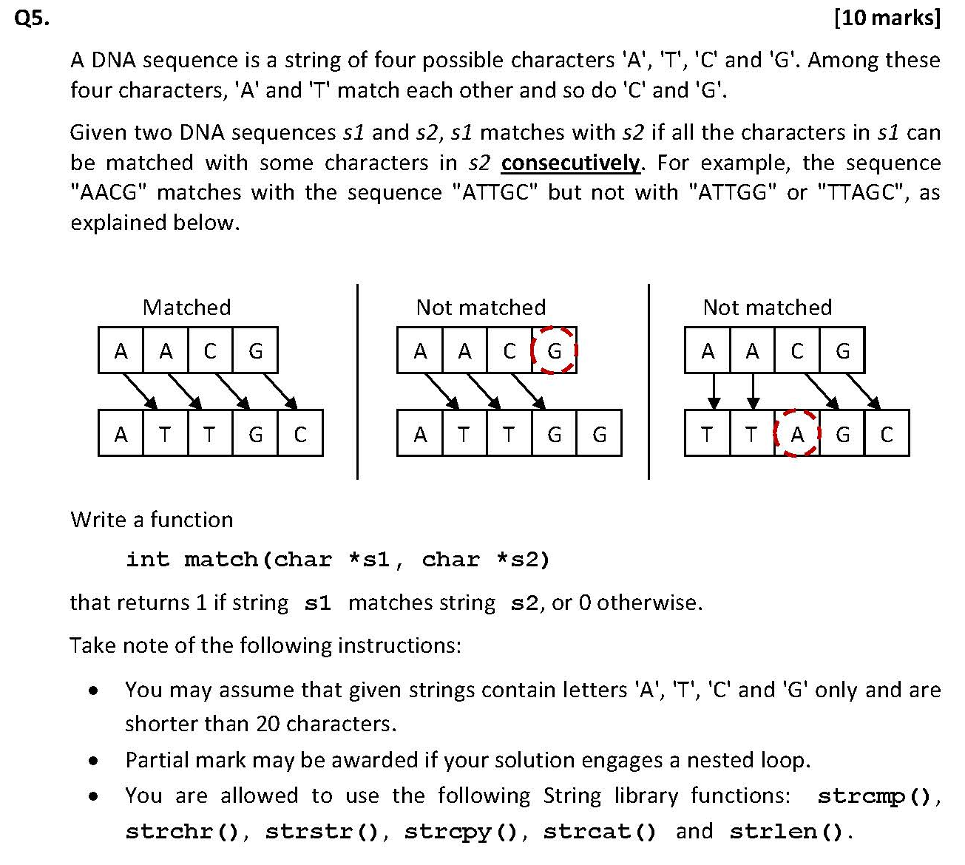
int match(char *s1, char *s2) {
int len1 = strlen(s1);
int len2 = strlen(s2);
// if s1 is longer than s2, cannot match
if (len1 > len2) return 0;
// all the possible starting points for s2
for (int i = 0; i <= len2 - len1; i++) {
int matched = 1;
// check whether the characters match
for (int j = 0; j < len1; j++) {
char c1 = s1[j];
char c2 = s2[i + j];
if (!((c1 == 'A' && c2 == 'T') ||
(c1 == 'T' && c2 == 'A') ||
(c1 == 'C' && c2 == 'G') ||
(c1 == 'G' && c2 == 'C'))) {
matched = 0;
break;
}
}
// if it finds the matched sequence
if (matched) {
return 1;
}
}
// check the whole string still do not match
return 0;
}
Answer:
(nested loops)

Slide 39
int match(char *s1, char *s2)
{
char comp[20];
int i;
for(i = 0; s1[i] != '\0'; i++)
{
if(s1[i] == 'A') comp[i] = 'T';
else if(s1[i] == 'T') comp[i] = 'A';
else if(s1[i] == 'C') comp[i] = 'G';
else comp[i] = 'C';
}
comp[i] = '\0';
if (strstr(s2, comp) != NULL) {
return 1
}
else {
return 0
}
}
Find complement sequence & use given function strstr()
strstr(s1, s2):
用来在一个字符串中查找另一个字符串第一次出现的位置
Eg.
char s[] = "abcdef";
char *p = strstr(s, "cd");
printf("%s\n", p);
a b c d e f \0
^
p
Output: cdef
If not found: return NULL
strstr(s1, s2)
Used to check whether s2 is the substring of s1

Slide 40
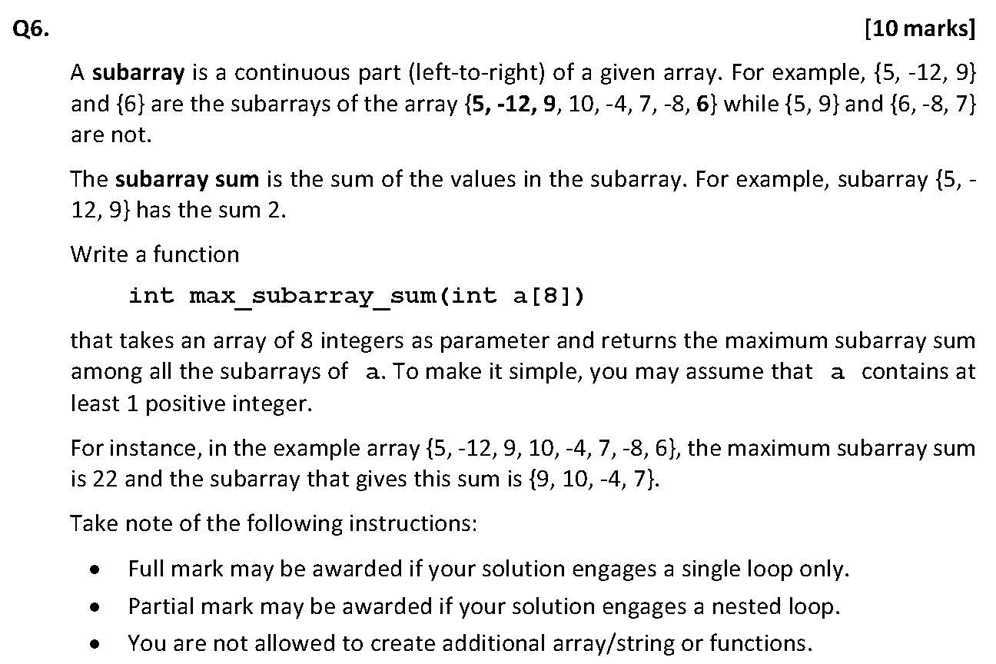
Answer:
Use one for loop (Kadane’s algorithm)

Slide 41
To make the sum the biggest
Avoid adding negative numbers and try to include all the non-negative numbers
int max_subarray_sum(int a[8]) {
int current_sum = 0;
int max_sum = 0;
for (int i = 0; i < 8; i++) {
current_sum += a[i];
if (current_sum < 0) {
current_sum = 0;
}
if (current_sum > max_sum) {
max_sum = current_sum;
}
}
return max_sum;
}
-1 | 2 | -3 | 7 | … | … | …
前三项为负，无论后面正负情况，加上这三项的和sum都变小，
因此放弃这三项，从后面开始。
Once the sum added up before is negative,
Delete all of them and start calculating again

Slide 42
Alternative method: nested loops
int max_subarray_sum (int a [ 8 ] ){
int i, j, current_sum, max_sum;
max_sum = a[0];
for (i = 0; i < 8; i ++){
current_sum = 0;
for (j = 0; j < 8 - i; j++){
current_sum = current_sum + a[i + j];
if (current_sum > max_sum) max_sum = current_sum;
}
}
return max_sum;
}
If it does not assume there is at least one positive number, this program will still work!

Slide 43
考试建议
先易后难，第一遍写不要先追求最优解
可以先写最慢但一定正确的解法
多层for-loops/while-loops
没有思路可以先跳过，保证会做的先做完
时间往往比较充足，保持稳定心态
考查recursion，思考：
Base case
每一层要做什么，需要什么前提条件 ➔用n表示一般情况

Slide 44
Q&A
如有疑问，请在聊天框发出题号和问题 ;)

Slide 45
祝大家考试顺利 大一顺利！
All the best!

Slide 46
- End -
Acknowledgement: The first draft of these solutions was provided by Liu Yuqi.

